Slide 1
CUSTOMER LOYALTY & Proximity marketing using ble beacons
Saikumar Nanjala
Sanketh N Bhagavanthi
Yashwanth Lingareddy
Venkata Sai Praneeth Kandula

Slide 2
PROBLEM STATEMENT
Loyalty programs for small and medium business are very less - Technology hurdles & high operating costs.
Need of loyalty programs to be shifted from cards to mobile app.
Difficult to carry different cards for different loyalty program.

Slide 3
SOLUTION
A simple cloud based Mobile and Web application that helps businesses
To design and run new loyalty programs
To migrate easily from traditional card/punch-card loyalty
To have personal, first hand and consistent interaction with their customers regarding offers, rewards etc.

Slide 4
SOLUTION
Mobile App – where users
Have complete details of all their participating loyalty programs
Make payment to vendors
Receive notifications on offers, rewards and other information from vendors.
Web App – where vendor
See complete shopping profile of their customers and know their preferences
Receive payments – maintain transaction history
Send personalized messages
Design and push campaigns

Slide 5
CHALLENGES
Identify consumers rapidly at point of sale (POS) to accumulate the rewards points and redeem them
The solution to work online and offline, also enable to process the offline messages in batches.
Identification of each customer while redeeming the rewards.

Slide 6
SOFTWARE REQURIEMENT SPECIFICATION (SRS)
Customer Mobile App (IOS & Android)
Registration
Mobile Number → OTP to that mobile number → set password → sign up
Home Screen
List all the shops the customer is associated with in that particular city as cards. Each card should contain store name and outstanding points available
Search Bar to search for stores
Option to change the City
Top left corner button for user profile
Top right corner button for QR code

Slide 7
SOFTWARE REQURIEMENT SPECIFICATION (SRS)
Each Store Screen
Banner Image with Name of the store
Distance from the user location (on the banner image)
On click of the distance, maps should open to show the directions
Timings, open or closed based on timings (on the banner image)
On top right corner button to display QR code
Button to make payment
Tabs - “Activity”, “Details”, “Profile”
The Activity tab should contain
Total Outstanding points
No of visits
Total points redeemed
Loyalty level (silver, gold, platinum)
Points to be gathered for entering into next level
All details of available rewards, if any

Slide 8
SOFTWARE REQURIEMENT SPECIFICATION (SRS)
The Details tab should contain
All the individual transaction details done by the customer in that store. Means each and every transaction of point’s addition and point’s redemption.
Each detail should contain date, address, points count, added or redeemed
The Profile tab should contain
Name of the store
Various places where the stores are located in that city, with phone numbers
Each Loyalty level`s explanation
Other store details
Profile Screen
On click of profile button in the home page
Header should contain Total store count, total visits, Profile pic
Should Contain Three tabs “Profile”, “My Activity”, Notifications

Slide 9
SOFTWARE REQURIEMENT SPECIFICATION (SRS)
First Name
Last Name
Date of Birth
Email Address
Phone Number
Option to change password
Gender
My Activity tab should contain the details of all the transactions of all stores in that city.
Notifications will store all the notifications send to that user
Top right corner should contain button for QR code
Option to add payment details

Slide 10
SOFTWARE REQURIEMENT SPECIFICATION (SRS)
Vendor – Business App
Sign-in
Email id → Password (No registration is required here because the business registrations are done via website only)
Should Contain
Two tabs “Add points”, “Redeem points”
In Add points tab
Bill amount field
Phone number / scan QR code field
Button beside scan QR code.
On click of the button QR reader should open in app
In redeem points tab
Scan QR code field (points cannot be redeemed unless the user has app in his phone)
After scanning the QR code, show total outstanding points, Customer basic info and a text box to enter the number of points to be redeemed.
Redeem button

Slide 11
SOFTWARE REQURIEMENT SPECIFICATION (SRS)
Vendor – Web Application
Request Register
Popup will contain one field “Email address”
Okay button. “Send verification email”
After clicking the verification link from email, will redirect to registration form
Registration form will contain
Set password
Shop Name
Shop type
Add outlet`s address, phone numbers
Add different logins for different outlets
Define Loyalty points for three levels. Amount: points ratio, any other benefits of individual levels
Button for “Submit request”

Slide 12
SOFTWARE REQURIEMENT SPECIFICATION (SRS)
Login
Email Id, password fields
Store Dashboard
Dashboard will contain the following menu
Overview
Transactions
Campaigns
Members
Billing
Settings
Overview
Total Visit count and Total Members
New members this month
Active members in each tier
Contribution of sales by each tier members & Total annual sales

Slide 13
SOFTWARE REQURIEMENT SPECIFICATION (SRS)
Transactions
Add points
Redeem points
Members
Total Members
Search Box
Sortable data table with columns
Check box
Profile pic
Name
Phone number
Email id
Status
Outstanding points
Last visit
Membership from date

Slide 14
SOFTWARE REQURIEMENT SPECIFICATION (SRS)
On click of each row a pop up should come with following details
Name, profile pic, Email, Date of Birth
Add points, text box for amount and add button
Total visits
Total points added
Total points redeemed
Total revenue made by the customer
History of visits
Campaign
Data table of number of campaigns done till date with columns date, message, members
Create Campaign Button
On click of Create Campaign button

Slide 15
SOFTWARE REQURIEMENT SPECIFICATION (SRS)
Text box for campaign message
Select member using filters like All, Silver, Gold, Platinum, Birthday week etc.
Send Button (If the customers are using app the message will be sent as notification else it will be sent as message)
Billing
Outstanding bill Details in data table format with pay button in each row
Bill downloadable as pdf
Credit Card details. Add/Remove cards
Settings
Editing of details like
Store Name
Store type
All the outlets address, phone numbers, email id and login ids
Loyalty points ratio, benefits of tiers

Slide 16
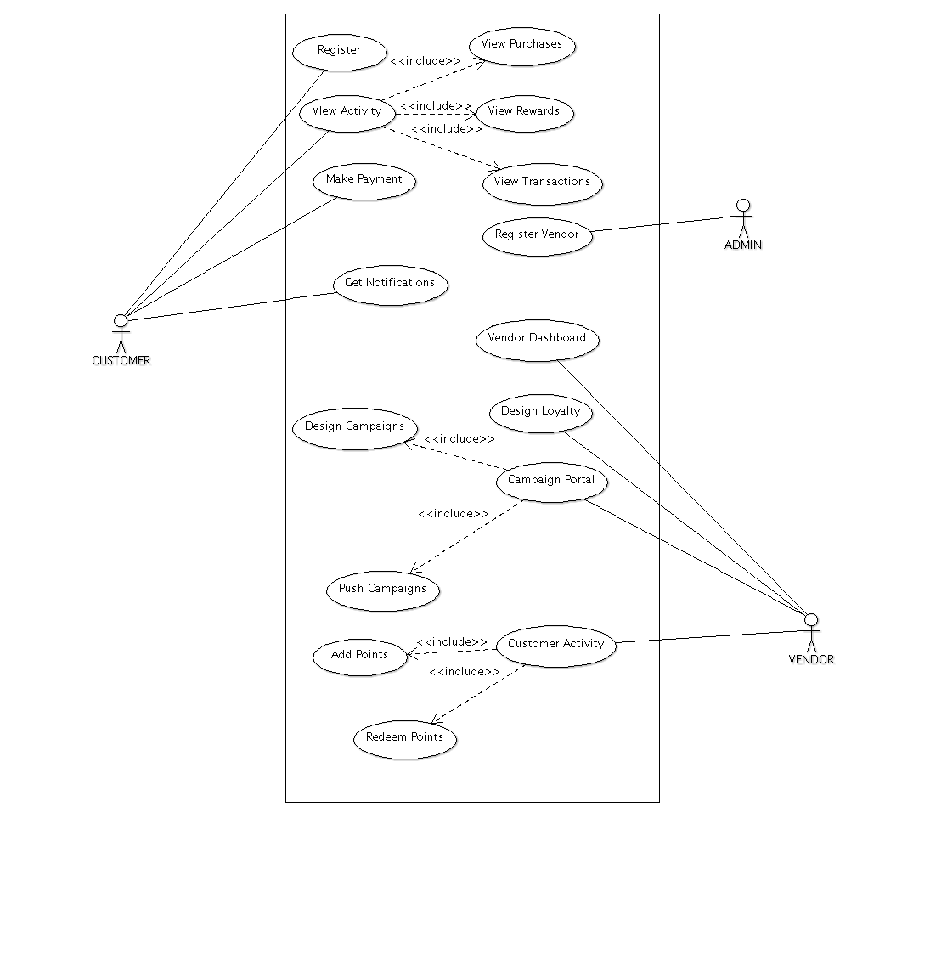
USE CASE DIAGRAM

Slide 17
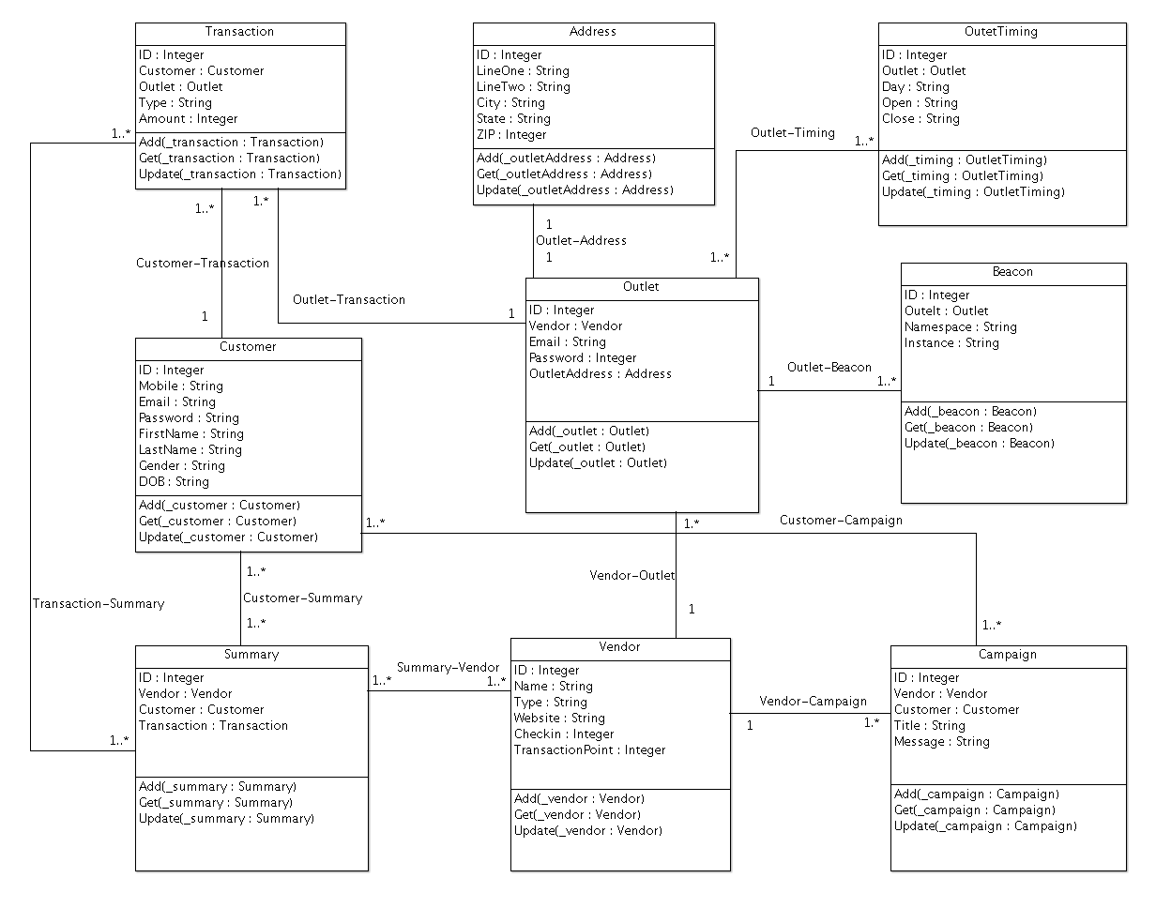
CLASS DIAGRAM

Slide 18
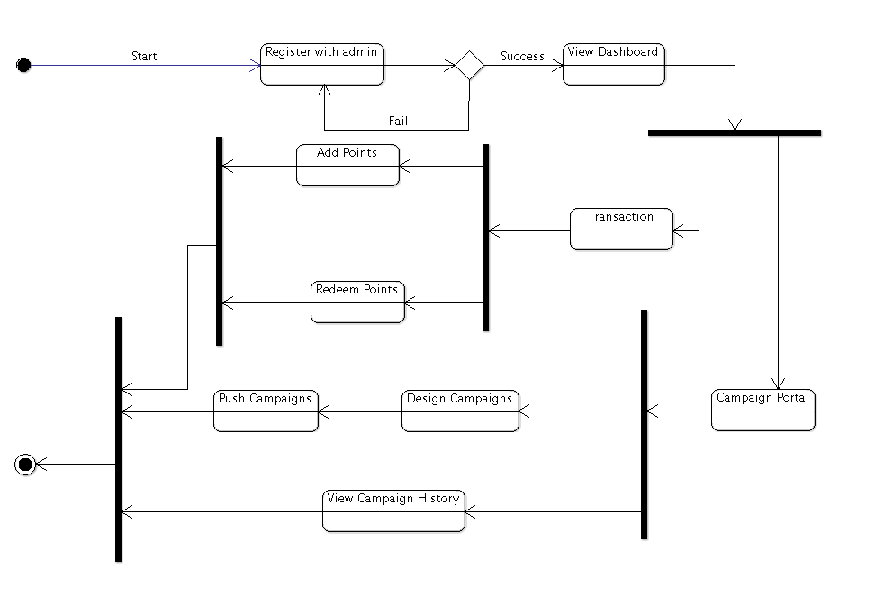
VENDOR STATE CHART

Slide 19
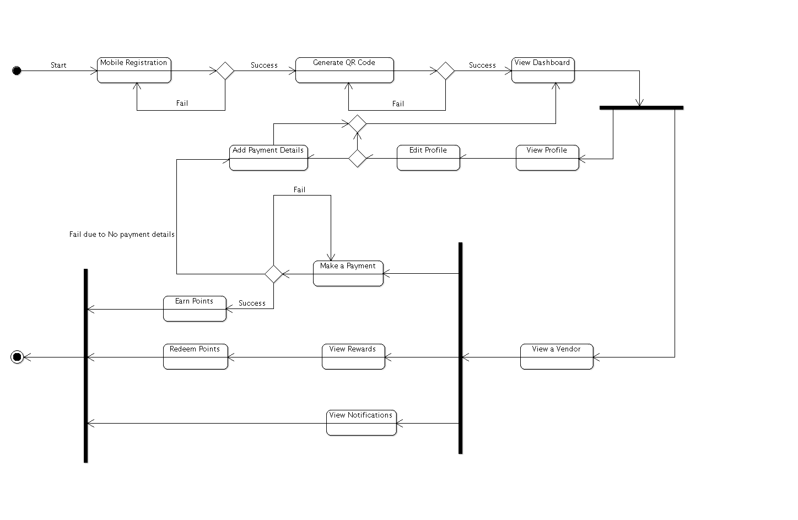
CUSTOMER STATE CHART

Slide 20
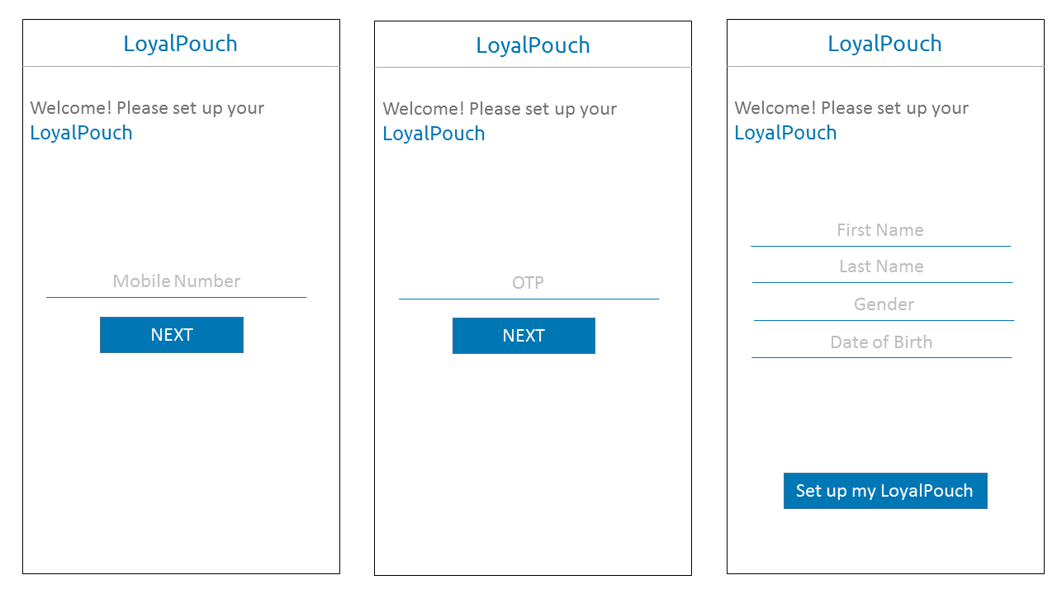
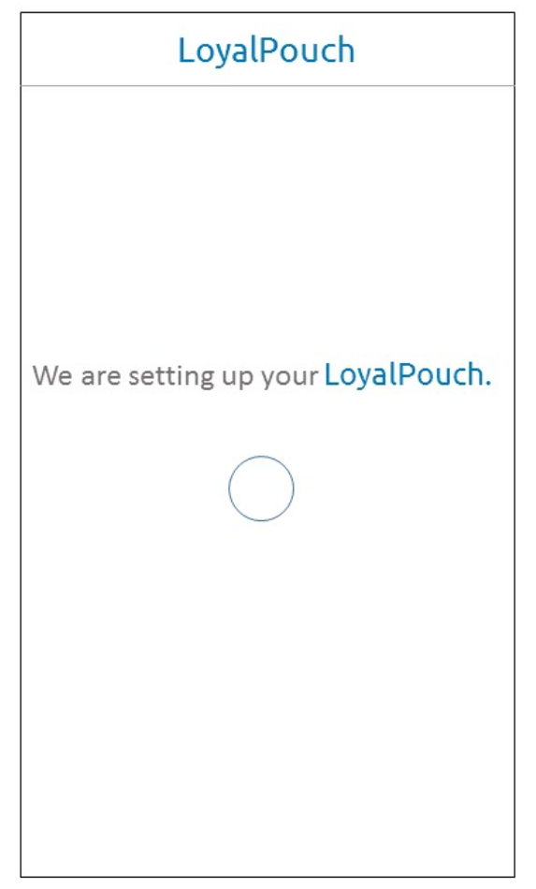
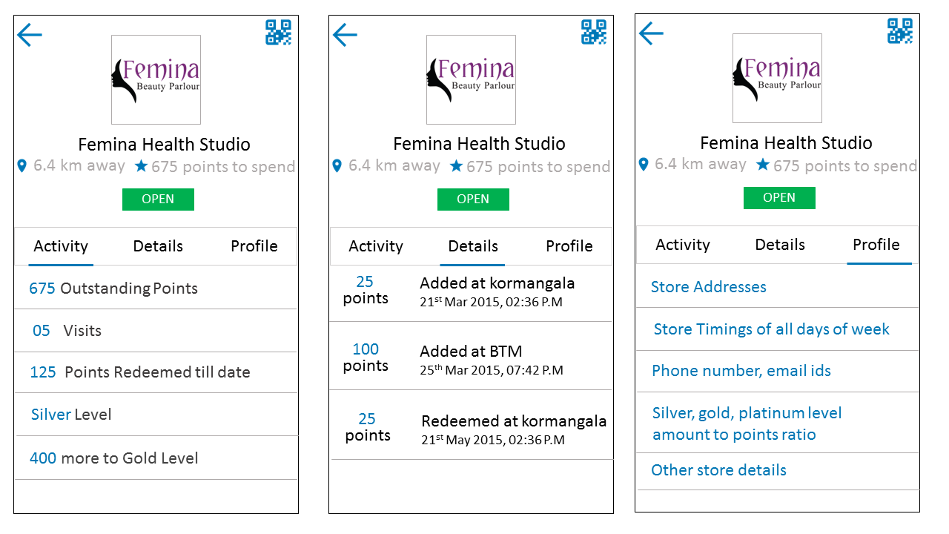
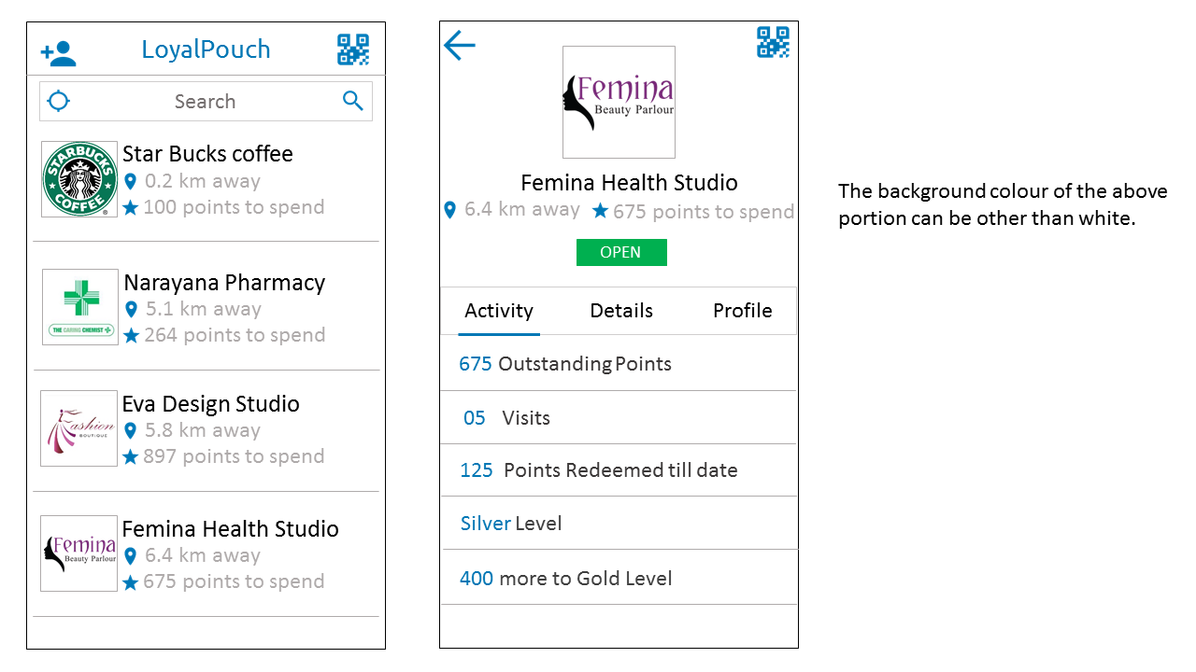
MOBILE WIRE FRAMES
(1) (2)
(3) (4)

Slide 21
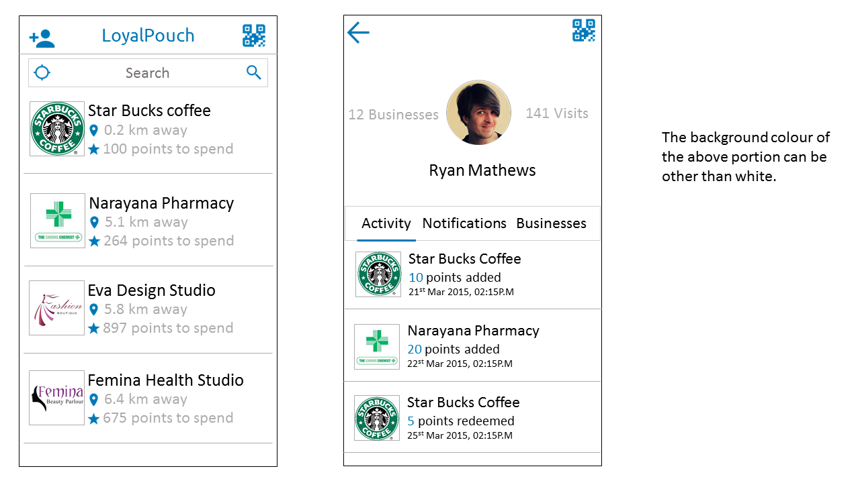
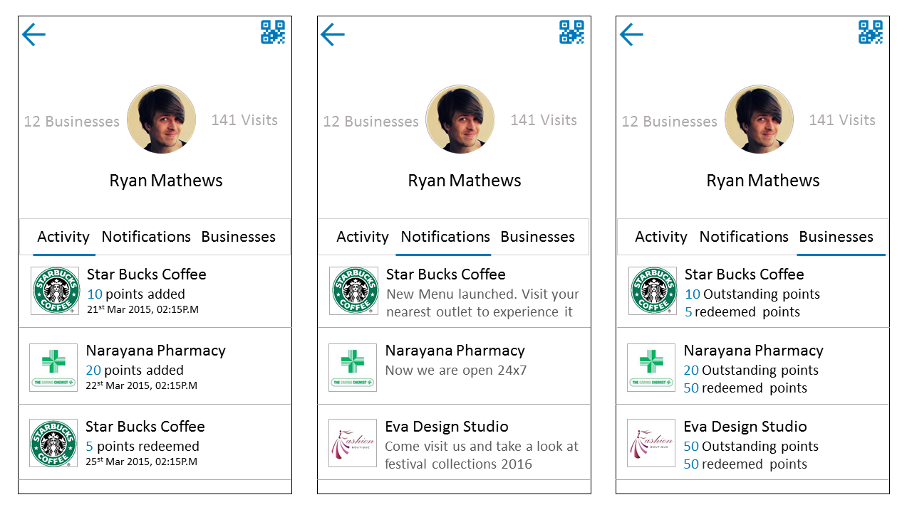
MOBILE WIRE FRAMES
(6)
(5)

Slide 22
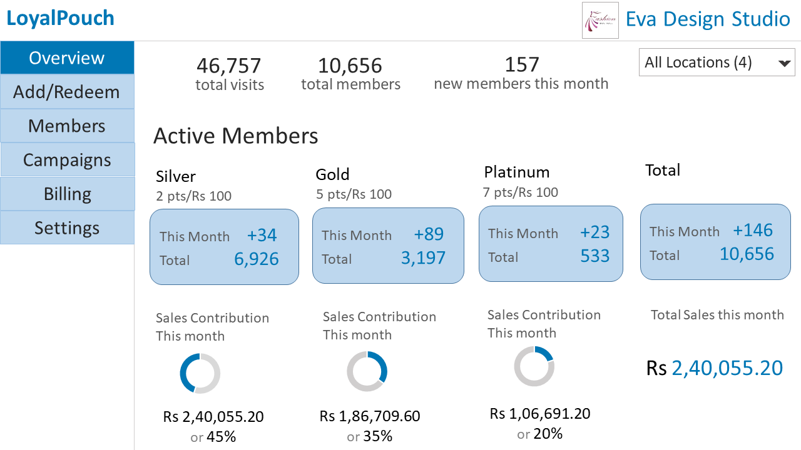
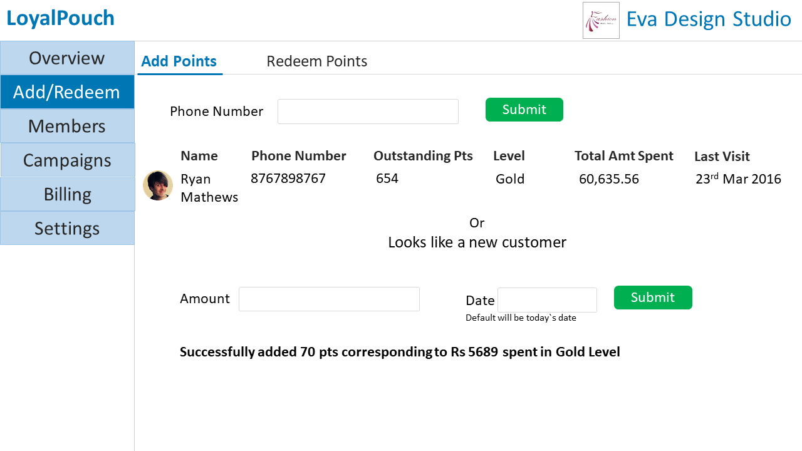
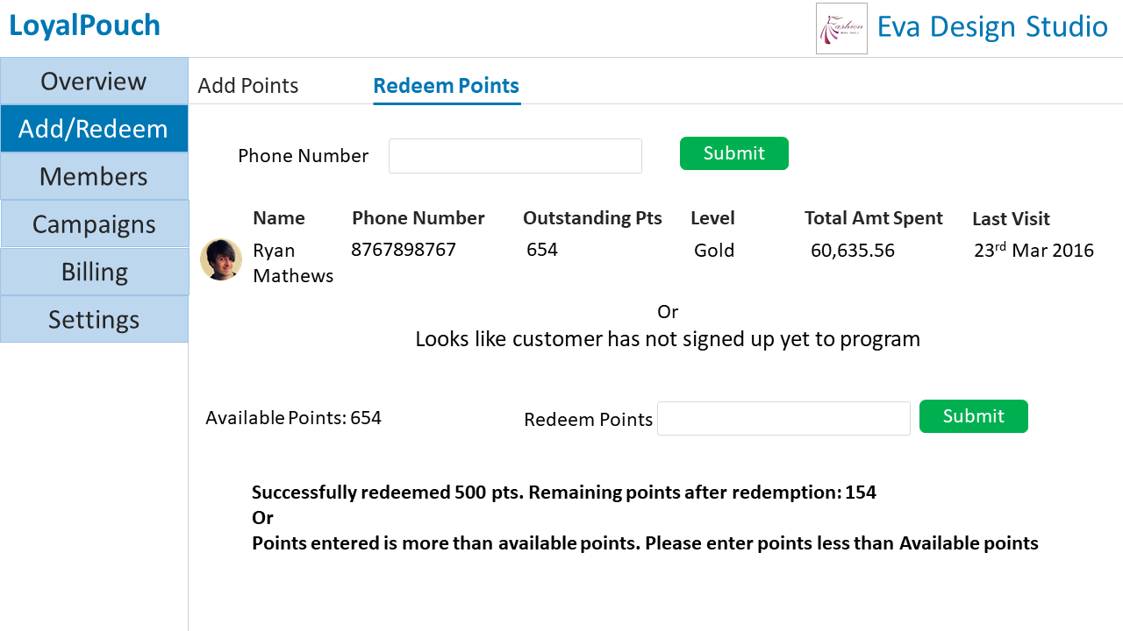
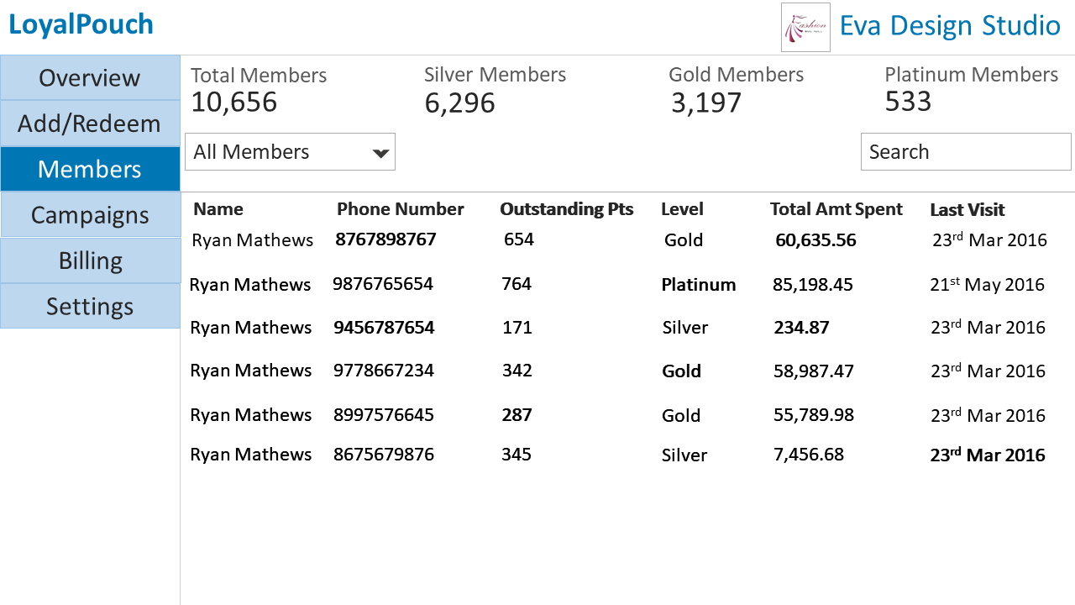
WEB PAGES

Slide 23
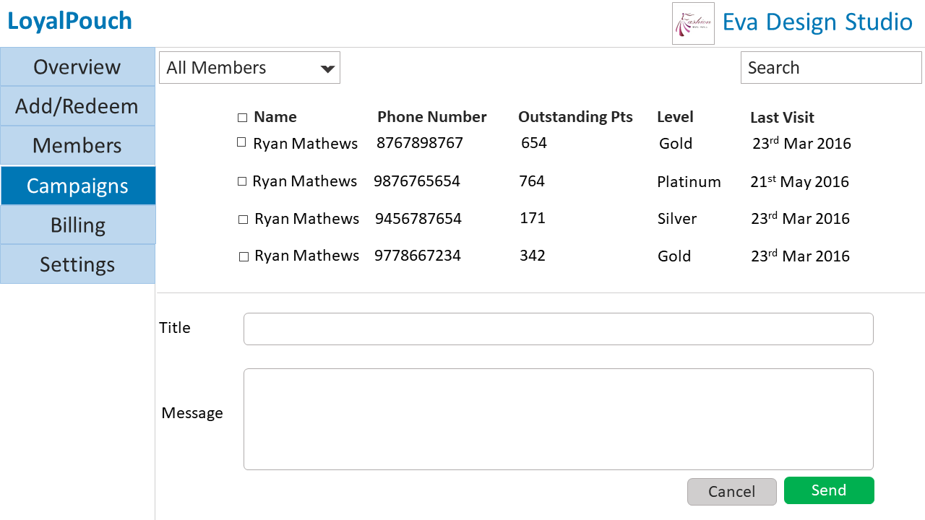
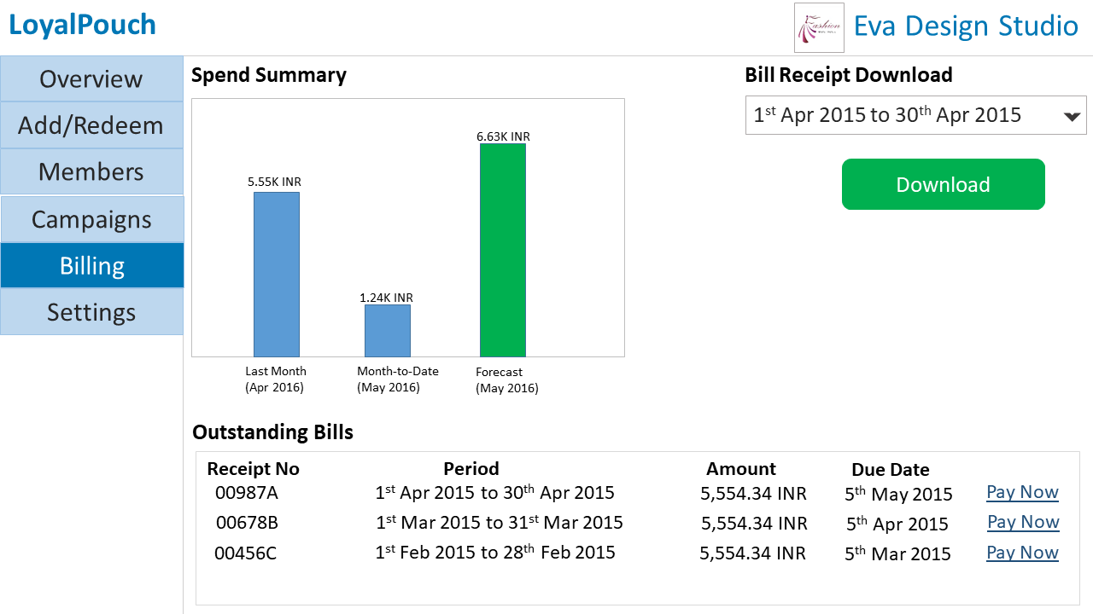
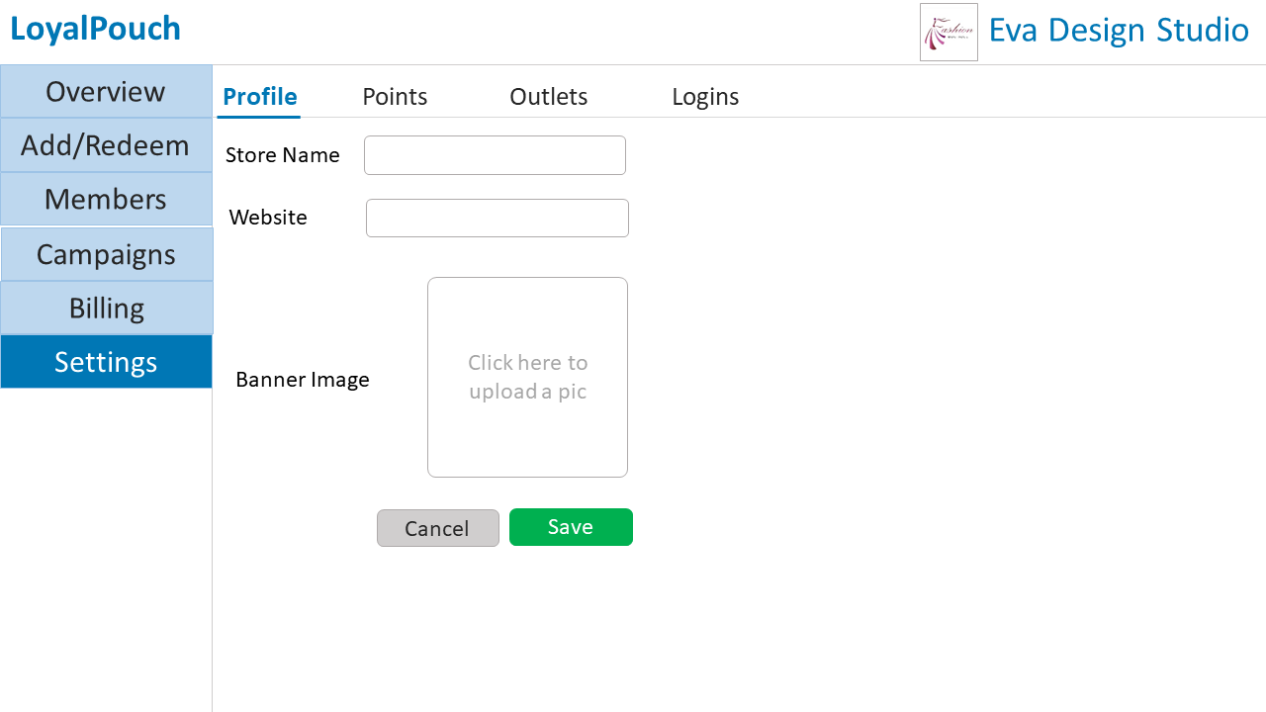
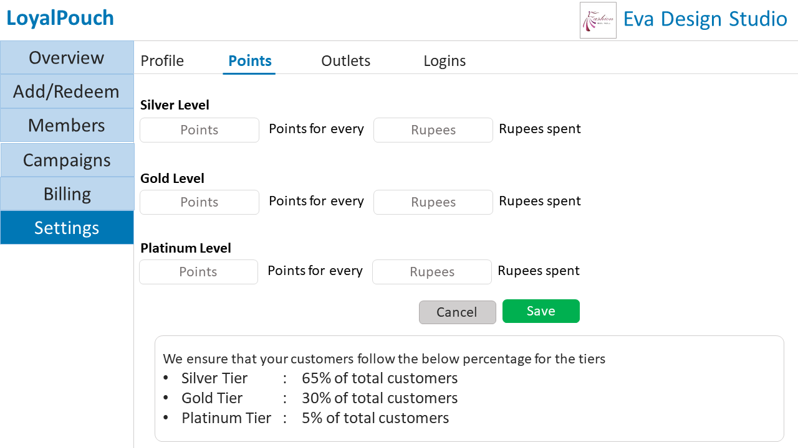
WEB PAGES

Slide 24
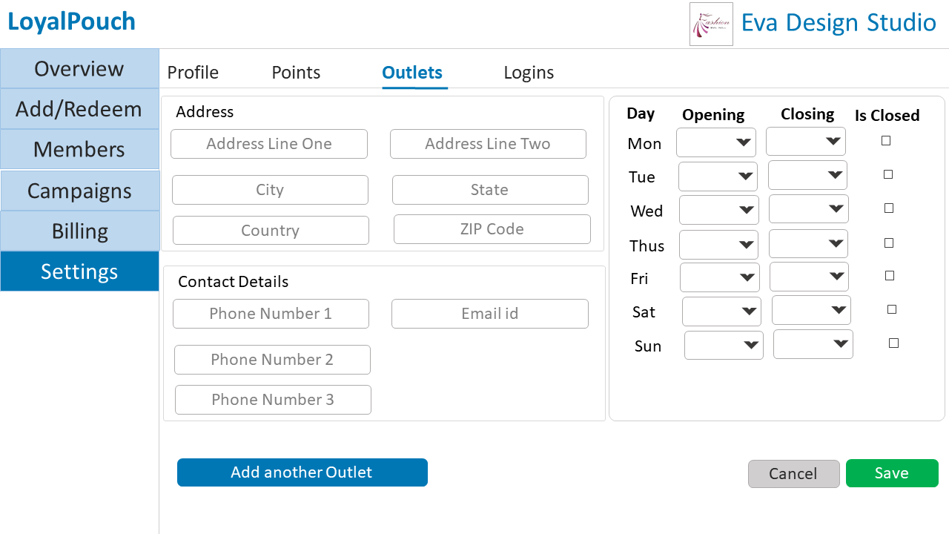
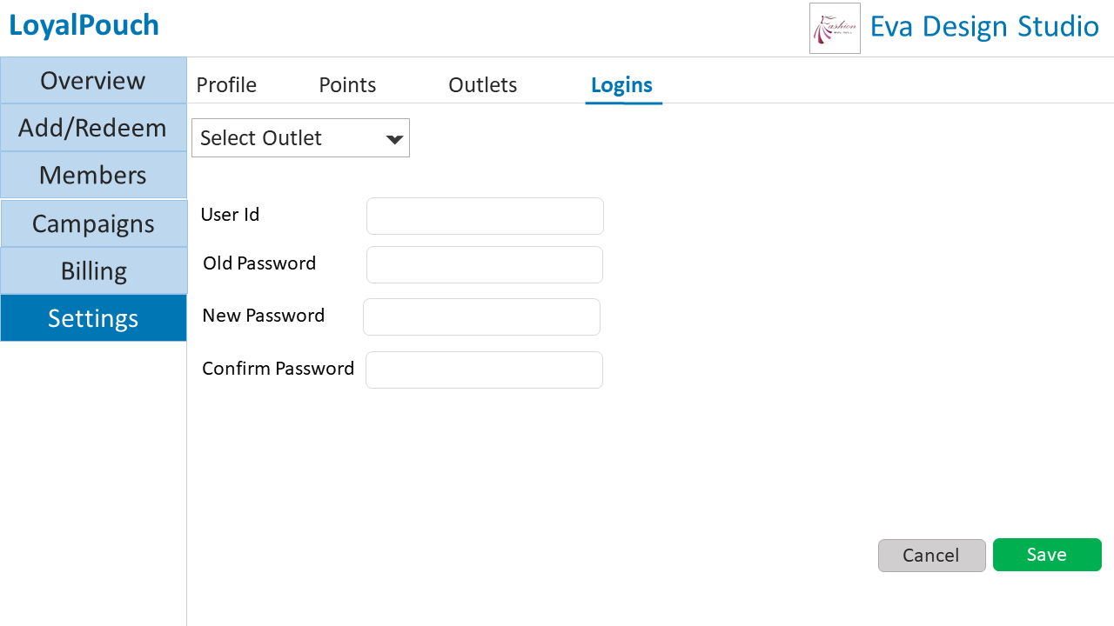
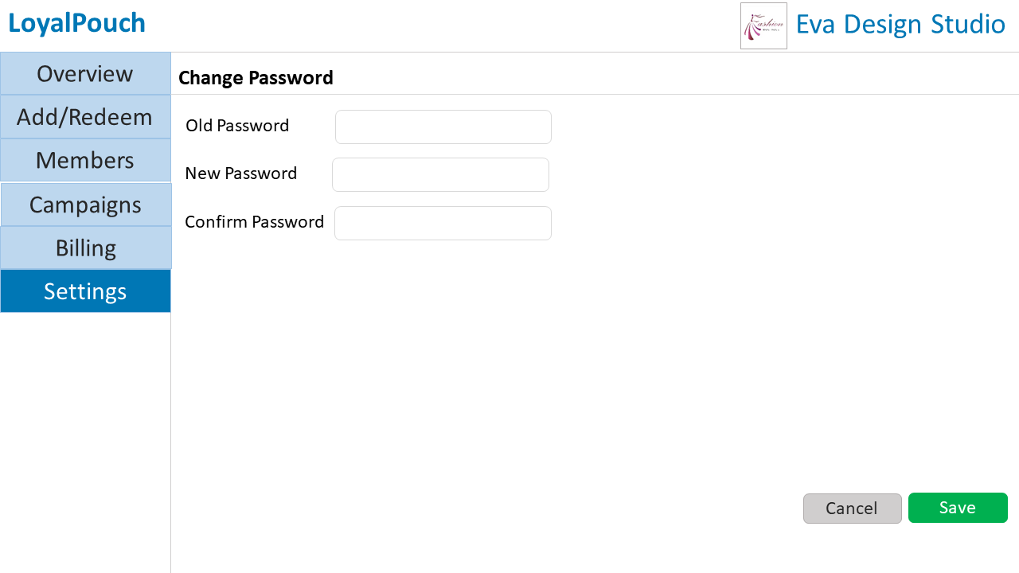
WEB PAGES

Slide 25
LIMITATIONS
User intervention is required for check-ins
Cannot record in-store product preferences of the customers
Lack of more specific marketing techniques like proximity marketing

Slide 26
RECOMMENDATION
Use of Bluetooth Low Energy(BLE) beacons in the system to overcome the above limitations BLE Beacons
These are hardware transmitters - a class of Bluetooth low energy (LE) devices that broadcast their identifier to nearby portable electronic devices.
This technology enables smartphones, tablets and other devices to perform actions when in close proximity to a beacon
Check-Ins
BLE beacons can be placed at the entrance of the store, such that any mobile device with the app cross the beacon gets recognized and automatic check-in can be done without user intervention

Slide 27
RECOMMENDATION
In-Store product preference
These beacons can be placed near each product in the store. When any mobile device enters the range of the beacon, the beacon registers the time spent by the mobile device in the beacon`s range.
the customer`s in-store preferences can be tracked, and appropriate targeted ad campaigns can be designed and pushed.
Proximity marketing
BLE beacons can detect any mobile device in a particular radius around the store. With this the customers can be notified with instant rewards or discounts when they are in vicinity of the store.
This achieves much more specific targeting of customers for ad campaigns.

